Slide 1

SPTA Meeting
September 5 2019

Slide 2
Class representatives
1st Years- Will Roark and Ariel McDole
2nd Years- Kalyn Kowalski and Drake Stevens
3rd Years- Brock Labelle and Madi Krebs

Slide 3
DUES
New members: $20
Renewing members: $5
Money due to any SPTA board member or Dr. Conrad

Slide 4
Future SPTA Meetings
All future SPTA meetings will be held on the first Thursday of every month at 3:00pm in RN 143
October Meeting: Thursday Oct. 3rd
November Meeting: Thursday Nov. 7th
December Meeting: Thursday Dec. 5th

Slide 5
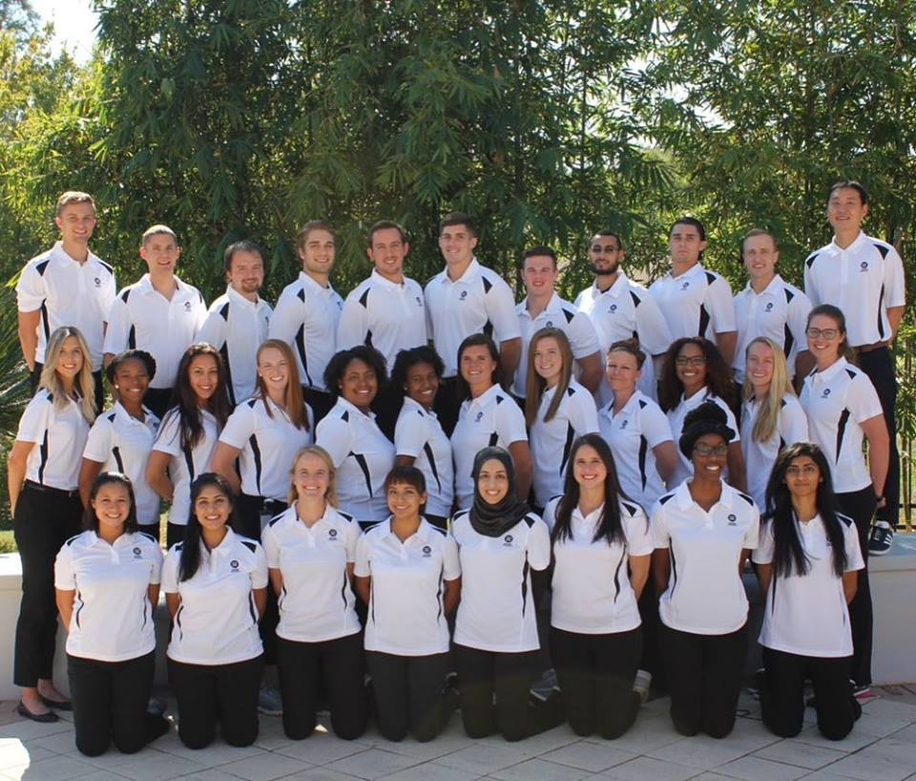
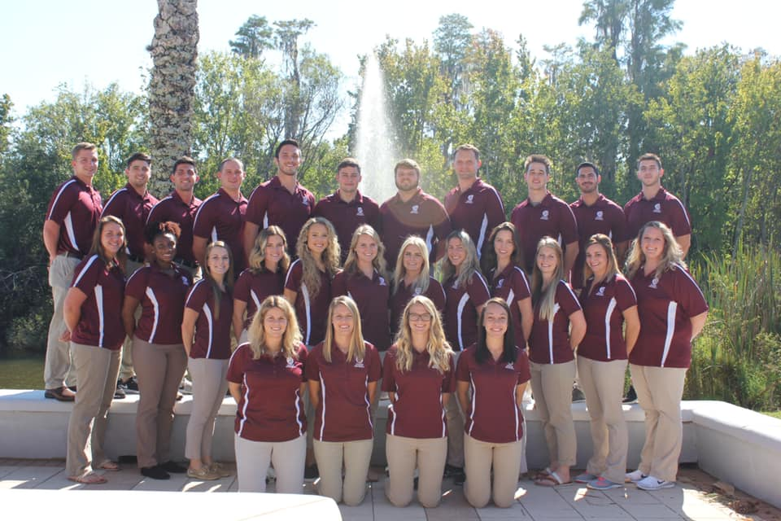
Picture Day
Thursday October 3rd before/after SPTA meeting
1st Years →Polos and khakis
2nd Years → Polos and black pants
3rd Years → Polos and khakis

Slide 6

SPTA social mixer
Thursday, September 26th 2019 at 6:00pm
Location TBD
Be on the lookout for poll

Slide 7
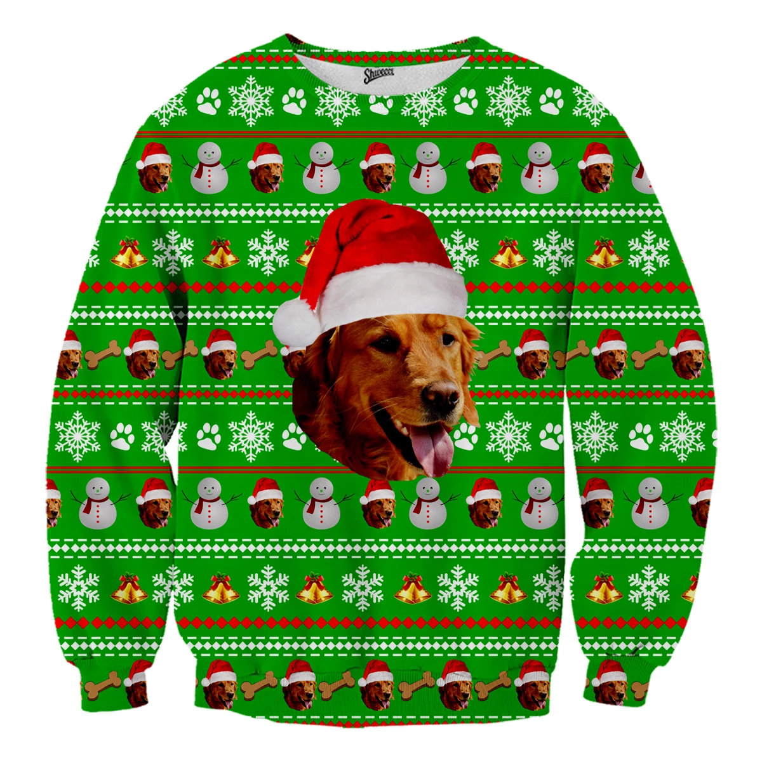



Fundraising
Ideas for the upcoming semester:
Basketball against professors
Pink day
Halloween Costume Competition
Ugly christmas/holiday sweater day
Candy Cane gram
Bingo night

Slide 8
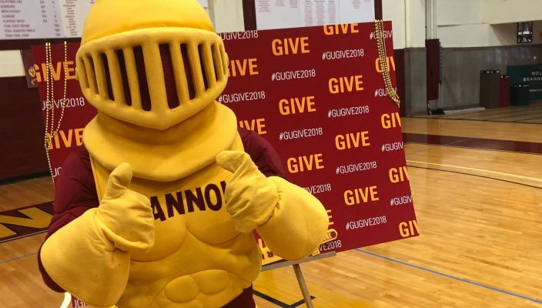

Community Service
4 hour requirement a year
Not related to Community Health Course
Give Day- September 21st 2019 10:00am-1:00pm
Sign up with Gannon Give Day and SEALS by Friday September 6th
SEALS RSVP: https://sealslife.com/events/ola/services/international-coastal-clean-up?olaT=2019-09-21T14%3A00%3A00.000Z&olaR=613499
Gannon RSVP: https://www.signupgenius.com/go/70a0c44a8a62ea0fd0-give1

Slide 9
Mentorship
Please sign up if you are interested in the mentorship program

Slide 10
Clothing order

Slide 11


Social Media
Website: https://spta-gannon-university0.webnode.com/
Email: SPTA@gannon.edu
Events Calendar (see website)

Slide 12
Committees
Fundraising
Community service
Social Media
White Coat
Graduation
Sign up to be a part of a committee

